Slide 1
Overview of Engineering Design Process
Author: Prof Johann Holm
Date: 2011-10-10

Slide 2
Overview of the life cycle
Page 1
Do requirements analysis (ask questions)
Do conceptual design (design system architecture)
Do preliminary design (break into smaller chunks)
Functional analysis (flow and architecture)
Requirements allocation (link to functions and resources)
Do detail design (electronics, code, mechanics)
Design, integrate, test (and test, and test, and test...)
Do manufacturing and / or construction
Use / operate and maintain the system
Phase out / recycle the system

Slide 3
Step 1: Analyse requirements
Page 2
Start by asking questions about:
What the system must DO (functional capability)
Where the system will be used (to understand transport etc)
Under what conditions (humidity, temperature, shock etc)
How we will use the system (to determine battery life, reliability etc)
How we will manufacture the product (how many, where etc)
How we will test the product (quality assurance)
Refer to B-Specification for a complete set of requirements / questions
Then we determine:
How will we achieve the above – i.e. using what (all the resources)?
Note: The answer to “HOW” is the creative part of the design process
Also: The WHAT-HOW cycle is done iteratively

Slide 4
Notes on WHAT and HOW
Page 3
High level requirements are addressed by low level resources
That is, WHAT at high level becomes HOW at lower level
Task at high level becomes process at lower level
Example:
Alarm panel /
Solar source
Operator
WHAT?
Do
Monitor alarm / Provide power
using
Comms and GUI /
Controller and Batt
HOW?
HOW?
Hardware
module Y
using
Firmware
Module X
Task A
Task B
Task C
Hardware
module Z
System behaviour
Workflow / State diagrams etc
System architecture

Slide 5
Step 2: Do functional analysis (1)
Page 4
Do functional flow (“dynamic” – processes at different levels)
Functional flow at operational level:
Then at technical level:
Still at technical level:
The C-code is detail...
Install unit
Train operator
Operate unit
[ref …]
What?
How?
[ref …]
Detect intrusion
Send intrusion code
[ref …]
becomes...
What?
How?
What? – How?
May also be flowcharts or state diagrams…
becomes...
[ref …]
Set up IP session
Send IP message
[ref …]
becomes...

Slide 6
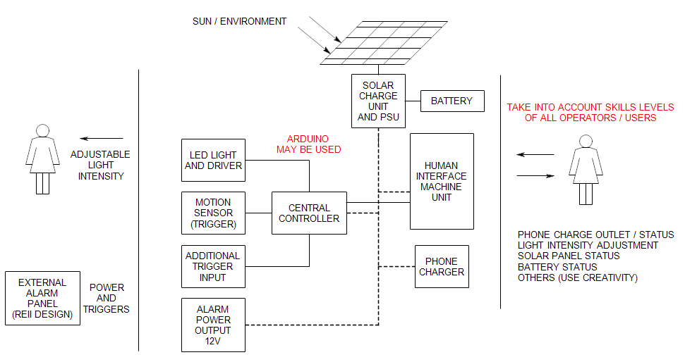
Step 2: Do functional analysis (2)
Page 5
Do architectural design (“static” – layout at different levels)
NB! Identify and label ALL interfaces and label ALL functional units
Note: The above is at technical level – break down into smaller units for more technical and detail level architectures (i.e. smaller components such as motors, C-code etc)
Must be broken down
into smaller units
Unit 1.1
Will be made up of hardware
and software “units”
I/F 1.1
Unit 1.2
Requirements will be “assigned” or
allocated to each functional unit

Slide 7
Step 3: Allocate requirements
Page 6
Identify requirements for each task and resource:
Functional capability (not optional – product MUST do this)
Performance (“how well” to perform each task – sometimes negotiable)
Environmental conditions (“design for’s” – actually requirements)
Usability, testability, maintainability, reliability (design for “ilities”)
NB! You have to define and allocate all requirements
Ensure requirements are allocated (linked to functions and resources)
Functional capability – does it work?
Performance – how well?
Shock / temperature / humidity / EMC?
Usability?
Testability?
Requirements are “allocated”
to functions, units and interfaces
Options – select one!
Unit 1.2
MIC3230
MIC3231
MIC3232
and UCS1001
Which one?
Regulate
PV power
Solar charge
Unit and PSU
using
using
Task
Functional unit
Technology

Slide 8
How to use “design for’s”
Page 7
Make a list of all applicable “design for’s”
Compile a list of all specific requirements:
Usability: Visual feedback (LED’s etc for diagnostics)
Usability: Simplistic interfaces (what makes things “usable”?)
Testability: Access to test points, BIT, diagnostics, test jig etc.
EMC: No large current loops, big ground plane, screening
EMC: Decoupling caps, etc.
Ensure the lists are complete – make list of 10 of each
Allocate each check list item to ALL applicable elements
Do you see that all “design for’s” are actually just design requirements?

Slide 9
Step 4: “Select” resources
Page 8
Identify all options
Do technology research
Identify selection criteria (cost, space, availability, reliability etc)
Draw up a decision matrix and make decision as below
Do we buy, or do we make?
Cost-performance is always an issue
Availability (single-source / manufacture / time)
It must “FIT”, i.e. interface requirements MUST be adhered to
 | Cost | Space | Availability | Reliability | Score
Option 1 | 8 | 6 | 8 | 6 | 7
Option 2 | 9 | 8 | 8 | 4 | 6.7
Option 3 | 8 | 8 | 8 | 4 | 6.4
Option 4 | 6 | 4 | 10 | 2 | 5
Weight | 0.3 | 0.1 | 0.2 | 0.4
Option 1 – Tech 1
Option 2 – Tech 2
Option 3 – Tech 3
Option 4 – Tech 4

Slide 10
Step 5: Do detail design
Page 9
Detail design, integrate, and test are iterative
Ex: Study DC/DC architectures thoroughly (Form)
Identify Technical Performance Measures (How well)
What makes the DC/DC “good”
Ex, current capability, max voltage, complexity etc
Identify Design-Dependent Parameters (Using what)
What influences current, voltage, complexity etc?
Ex, FET’s RDS_{ON} and max voltage / current, layout, etc
Build and test, build and test, build and test...
Integrate with other elements / components (Fit)
Test, test, test... That is, verify and validate

